Slide 1



Post 14 Pathways Evening
The Priory School, Hitchin
Excellence in education, for every young person, every day
26th March 2026
www.priory.herts.sch.uk

Slide 2

Please Silence Your Mobile Phone

Slide 3

Welcome
Faye Nearney
Deputy Headteacher

Slide 4

Online safety
Report remove – remove images from
the internet
Financially motivated sexual extortion
Asking the awkward

Slide 5
Learning Pathways
Students allocated pathways based on previous data, targets and discussions with SENCO, Head of Year and Head of Key Stage 3.
This is the pathway that we feel will give your son / daughter the greatest opportunity to succeed.

Slide 6

Core: Everyone Will Take
English (literature & language)
Maths
Science (double or triple – as decided by The Science Department in June)
At least one humanity (geography or history)
Cultural Respect and Responsibility (CR&R)
Core Physical Education

Slide 7
Learning Pathway 1
Students have bespoke timetable
College/ work experience
Art GCSE | Health & Social Care BTEC | PG GCSE*
Creative iMedia Cambridge National Level 2 | History GCSE | Performing Arts BTEC
Design and Technology GCSE | Media Studies GCSE | Philosophy & Ethics GCSE
Film Studies GCSE | Music Practice BTEC | Spanish GCSE
Food and Nutrition GCSE | Music* GCSE | Sport Studies OCR National
French GCSE |  | Travel and Tourism BTEC

Slide 8
Learning Pathway 2
Students choose history or geography
Students will have 3 additional subjects to take (and choose a reserve)
Students study double or triple science
3 additional subjects
Art GCSE | Health & Social Care BTEC | Psychology* GCSE
Business Studies GCSE | History GCSE | Sociology* GCSE
Computer Science* GCSE | Media Studies GCSE | Spanish GCSE
Creative iMedia Cambridge National Level 2 | Music* GCSE | Sport Studies OCR National
Design and Technology GCSE | Music Practice BTEC | Statistics GCSE
Film Studies GCSE | PE GCSE* | Travel and Tourism BTEC
Food Preparation and Nutrition GCSE | Performing Arts
French GCSE | Philosophy & Ethics GCSE

Slide 9
Subjects With Additional Criteria
Subject | Criteria
Computer Science* | Target grade 5 in Maths
Sociology* | Target grade 4 in English
Psychology* | Target grade 5 in Science
PE GCSE* | Target grade 5 in Science
Music GCSE* | Minimum of grade 2 Music

Slide 10

Making Your Requests
Requests are made via the SIMS app
This will go live Monday 13th April
If you wish to study both History and Geography, you need to choose Geography in the Humanities request box, and History in the subject request box
You need to identify 4 subjects. One subject is a reserve.
Number them in order of preference
You can only pick one Design Technology subject, this includes Food and Nutrition
Deadline is Friday 17th April

Slide 11
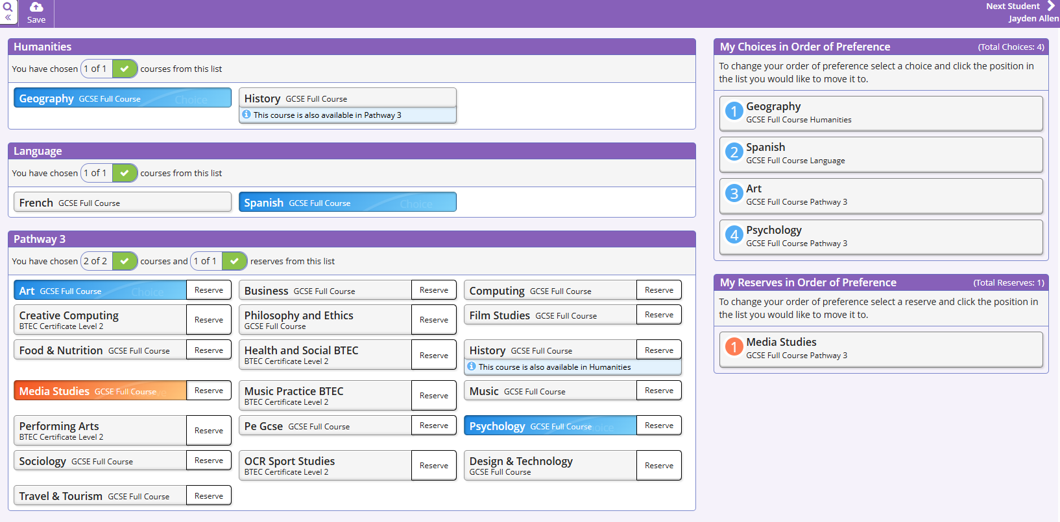

Slide 12
Learning Pathways
Within the pathways the subject requests are ‘open’ – they are not yet in blocks.
Once students submit their requests (17th April) we block the subjects.
We aim to maximise ‘top 3’ requests but some students will need to study their reserve subject.
Block A | Block B | Block C
Art GCSE | Art GCSE | Spanish
Computing GCSE | Computing GCSE | Business GCSE
French GCSE | Food and Nutrition GCSE | French GCSE
Food and Nutrition GCSE | Creative Computing NCFE | Health and Social Care BTEC
History GCSE | Music Practice BTEC | Media Studies GCSE

Slide 13
Grade comparison
NEW GCSE
9
8
7
6
5 (Strong pass)
4 (Standard pass)
3
2
1
UNGRADED
OLD GCSEs
A*
A
B
C
D
E
F
G
UNGRADED
VOCATIONAL
DISTINCTION
MERIT
PASS
LEVEL 1 PASS
UNGRADED

Slide 14
Assessment
GCSE subjects – all exams at the end of year 11.
Students will need to return in September and be ready for the hard work ahead. They will be covering topics which may be only briefly revisited before their exams at the end of Year 11.
Reading skills need to be good!
OCR National and BTEC Courses have an exam which accounts for 25 – 40% of the qualification. The remaining % is coursework.

Slide 15

Which Direction?
School?
College?
Apprenticeship?
T Levels
Notes:
15

Slide 16
Employees and universities are looking for students to achieve the best grades they possibly can - pick what you enjoy and are good at!
Progression
Apprenticeship
BTEC Level 2/3
T Level
Further Education
Learning Pathway 1
Level 2
Apprenticeship
BTEC Level 3
T Level
A Levels
Learning Pathway 2
Level 2
Apprenticeship
BTEC Level 3
T Level
A Levels
Key Stage 4
Post 16
Notes:
The important thing to note here is that all 3 learning pathways provide our students with viable routes of progression at Post 16 level.
The most important thing at the end of year 11 is going to be securing the best possible grades that they can. However, it is important now that they request subjects that will lead into either Post 16 qualification or careers pathways that they would like to take. This is why as a school we have bought into an online package called Unifrog. All year 9 students have access to this as have parents and I would encourage you to use it with your child to investigate what is out there for them.

Slide 17
6th Form Entry Requirements
Standard entry requirement for the Hitchin Consortium is five Grade 9-4 GCSEs or equivalent including English and Maths at Grade 4 or above
Some subjects will have additional entry requirements and all have a recommended GCSE Average Points Score (APS)
The APS requirement means that it is important for students to perform well in all their KS4 subjects
Notes:
At TPS we work as part of a consortium with HGS and HBS. The entry requirements are the same across all 3 schools.
17

Slide 18
FAQs
Will every subject currently on offer be available?
  Whilst we try to ensure this, sometimes we have a change in staffing, or numbers are too low for a subject to run. Students will be spoken to about this if it happens and parents will receive a letter.
  Staffing constraints mean we can only offer one class for certain subjects. We may only be able to offer one business GCSE class.
Can I change my pathway?
  We have placed you on the pathway we feel offers you the best opportunity to succeed but appreciate that some students may want more flexibility in their choice. Parent needs to email Mrs Nearney to change.

Slide 19
FAQs
Is it true that GCSEs are better than BTECs or Cambridge Nationals
  No. We offer highly regarded courses which have been approved by OFQUAL and Department for Education.

Slide 20
FAQs
How will students be assigned to the combined science or triple science course?
  Students will be assigned to sets at the end of Year 9 and the top set(s) will follow the triple science course. All other students will follow the combined science course. Setting will be based on performance to date (KS2 and KS3) and assessments in the second half of Year 9 on the GCSE work they are studying. We also take into account students’ maths and English ability and their attitude and work in lessons.
Why does the school decide rather than making triple science an option?
  The triple science course is fast-paced (50% more content in the same number of lessons) and demanding (some of the extra content is bridging into A-level work). We need to make sure that students are on the course in which they have the best opportunity to succeed.

Slide 21
GCSE Science
All students will take GCSE science qualifications and will study biology, chemistry and physics.
Students will be taught in sets and will have 10 lessons of science per fortnight.
Students have already started their GCSE science courses and will have completed some elements of each subject by the end of Year 9.
Please fill in the form if you wish to student science at A level
Combined Science
Students taking the combined science course will gain a double award GCSE in science, which will consist of elements of all three sciences.
Triple Science
Students taking the triple science course will gain three separate GCSEs in biology, chemistry and physics. This will involve 50% more content than the combined science course.

Slide 22
Edexcel Level 3 Algebra Award
For those students in Set 1 we offer the Algebra Award, a standalone qualification which helps support students aiming for Grade 8 or 9
There is a significant overlap with GCSE Algebra topics, this allows for more practice and revision for this course which will directly support their revision.
Level 3 algebra will help bridge the gap between GCSE and A-level. For those not intending to study A-level mathematics, it gives a deeper understanding of the higher GCSE algebra topics.
The award is worth 7 UCAS points which would support any further education application
Assessed with one non-calculator exam, this is a Pass/ Fail exam.

Slide 23
Subjects upstairs
Health and Social Care
Psychology
Sociology
Travel and Tourism

Slide 24
Thank You
Please make your way through to the Sixth Form study centre

Slide 25
Post 14 Pathways Evening
The Priory School, Hitchin
Excellence in education, for every young person, every day
26th March 2026
www.priory.herts.sch.uk

